Slide 1
Causal LQM Insurance Insight Engine

Slide 2
Objective of the Product
Empower Chubb teams to make faster, smarter decisions by revealing the true causes behind claims, risks, and customer behavior—enabling proactive action, not just reaction

Slide 3
My Users Are
Executives: Oversee business performance, strategy, and compliance.
Underwriters: Assess and price risk accurately. Claims Managers: Detect fraud, speed up settlements, and control losses. Actuaries &
Analysts: Model scenarios, forecast trends, and optimize portfolios.
Customer Service: Deliver personalized, timely support

Slide 4
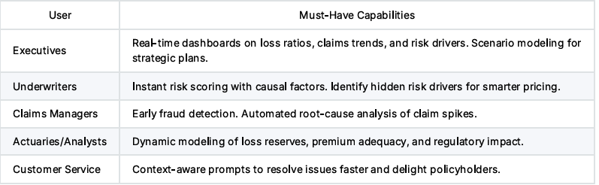
Must-Haveʼs for Each User

Slide 5
What Will Wow Your User? Customer Delight Factor
Executives: “What if?” scenario simulator to instantly see the business impact of regulatory or market changes. Underwriters: One-click identification of non-obvious risk factors, reducing manual review time by 40%.
Claims Managers: AI-powered fraud detection, catching 10%+ more fraudulent claims than traditional methods . 1
Actuaries/Analysts: Live data integration—forecasts update automatically as new data arrives, improving forecast accuracy by up to 70% . 2
Customer Service: Personalized recommendations that reduce customer churn and increase satisfaction.

Slide 6
What Metric Will Move
Loss Ratio: Reduced by catching more fraud and improving risk selection.
Claims Processing Time: Decreased by automating root-cause and fraud detection.
Forecast Accuracy: Improved for claims, premium revenue, and reserves.
Customer Satisfaction NPS Increased by faster, more personalized service

Slide 7
By How Much Will the Metric Move? Dollar Impact
Loss Ratio: Industry leaders using causal AI report over 10% reduction in undetected fraud, directly improving profitability . 3
Claims Processing Time: AI automation can cut processing from weeks to minutes, reducing operational costs and retaining $34B in premiums at risk from dissatisfied customers . 2
Forecast Accuracy: Companies like Branch improved forecast accuracy by 70% and saved 5 days per month on reporting .
Customer Retention: Faster claims and better service can reduce churn, protecting millions in recurring premium revenue.
Example: If Chubbʼs annual claims payout is $1B, a 10% reduction in fraud and improved claims management could save $100M per year

Slide 8
Market Validation
The insurance industry is leading the adoption of causal AI, with the BFSI sector holding the largest market share.
Allstate, JPMorgan, and Citibank have documented double-digit improvements in fraud detection and customer retention using causal models
The global causal AI market is growing at 41.8% CAGR, projected to reach $456.8M by 2030

Slide 9
Summary Slide
> Causal LQM Powering Chubbʼs Next Leap
> - Unmatched insights for every insurance role
> - Real, measurable impact: lower losses, faster claims, happier customers
> - Proven by industry leaders, ready for Chubb
Tip: Use visuals like before/after charts (claims processing time, loss ratio), user persona icons, and dollar impact infographics to make your slides pop and keep the message focused on business value

Slide 10
References
Use visuals like before/after charts (claims processing time, loss ratio), user persona icons, and dollar impact infographics to make your slides pop and keep the message focused on business value. ⁂
https://www.marketsandmarkets.com/PressReleases/causal-ai.asp
https://www.causal.app/case-study/branch-insurance
https://www.shift-technology.com/resources/perspectives/ai-in-insurance-from-buzzword-to-bottom-li n

